Slide 1
Scientific Presentation :
Artificial intelligence system reduces false-positive
findings in the interpretation of breast ultrasound
exams
Presenter : Anoop Johny
Semester 2
Masters Student
Life Science Informatics
Life Science Informatics Department
University of Bonn

Slide 2
Content
Introduction. S.no 3
Methods. S.no 10
Results. S.no 12
Performance. S.no 17
Use cases S.no 25
Discussion S.no 28
Conclusion S.no 32
References. S.no 34

Slide 3
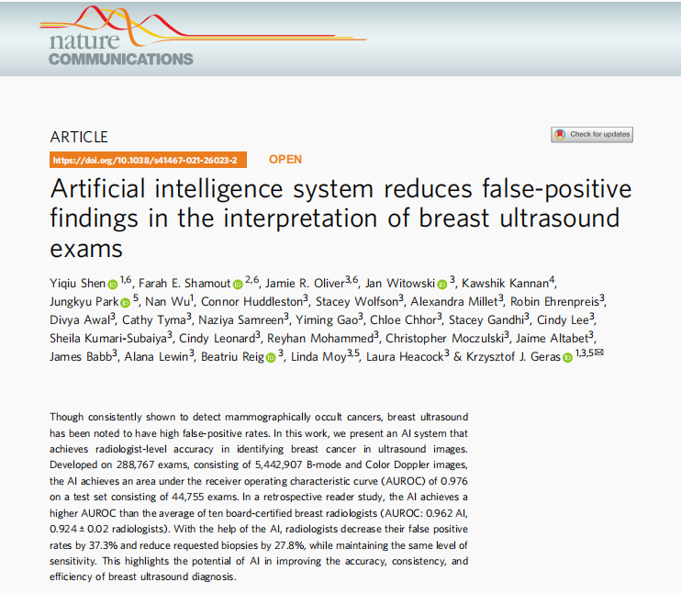
Introduction
Article : Open Access.
Published : 24 September 2021
Title : Artificial intelligence system reduces false-positive findings in the interpretation of breast ultrasound exams
Published in : Nature Communications, September 2021
DOI : 10.1038/s41467-021-26023-2
Pubmed ID : 34561440

Slide 4
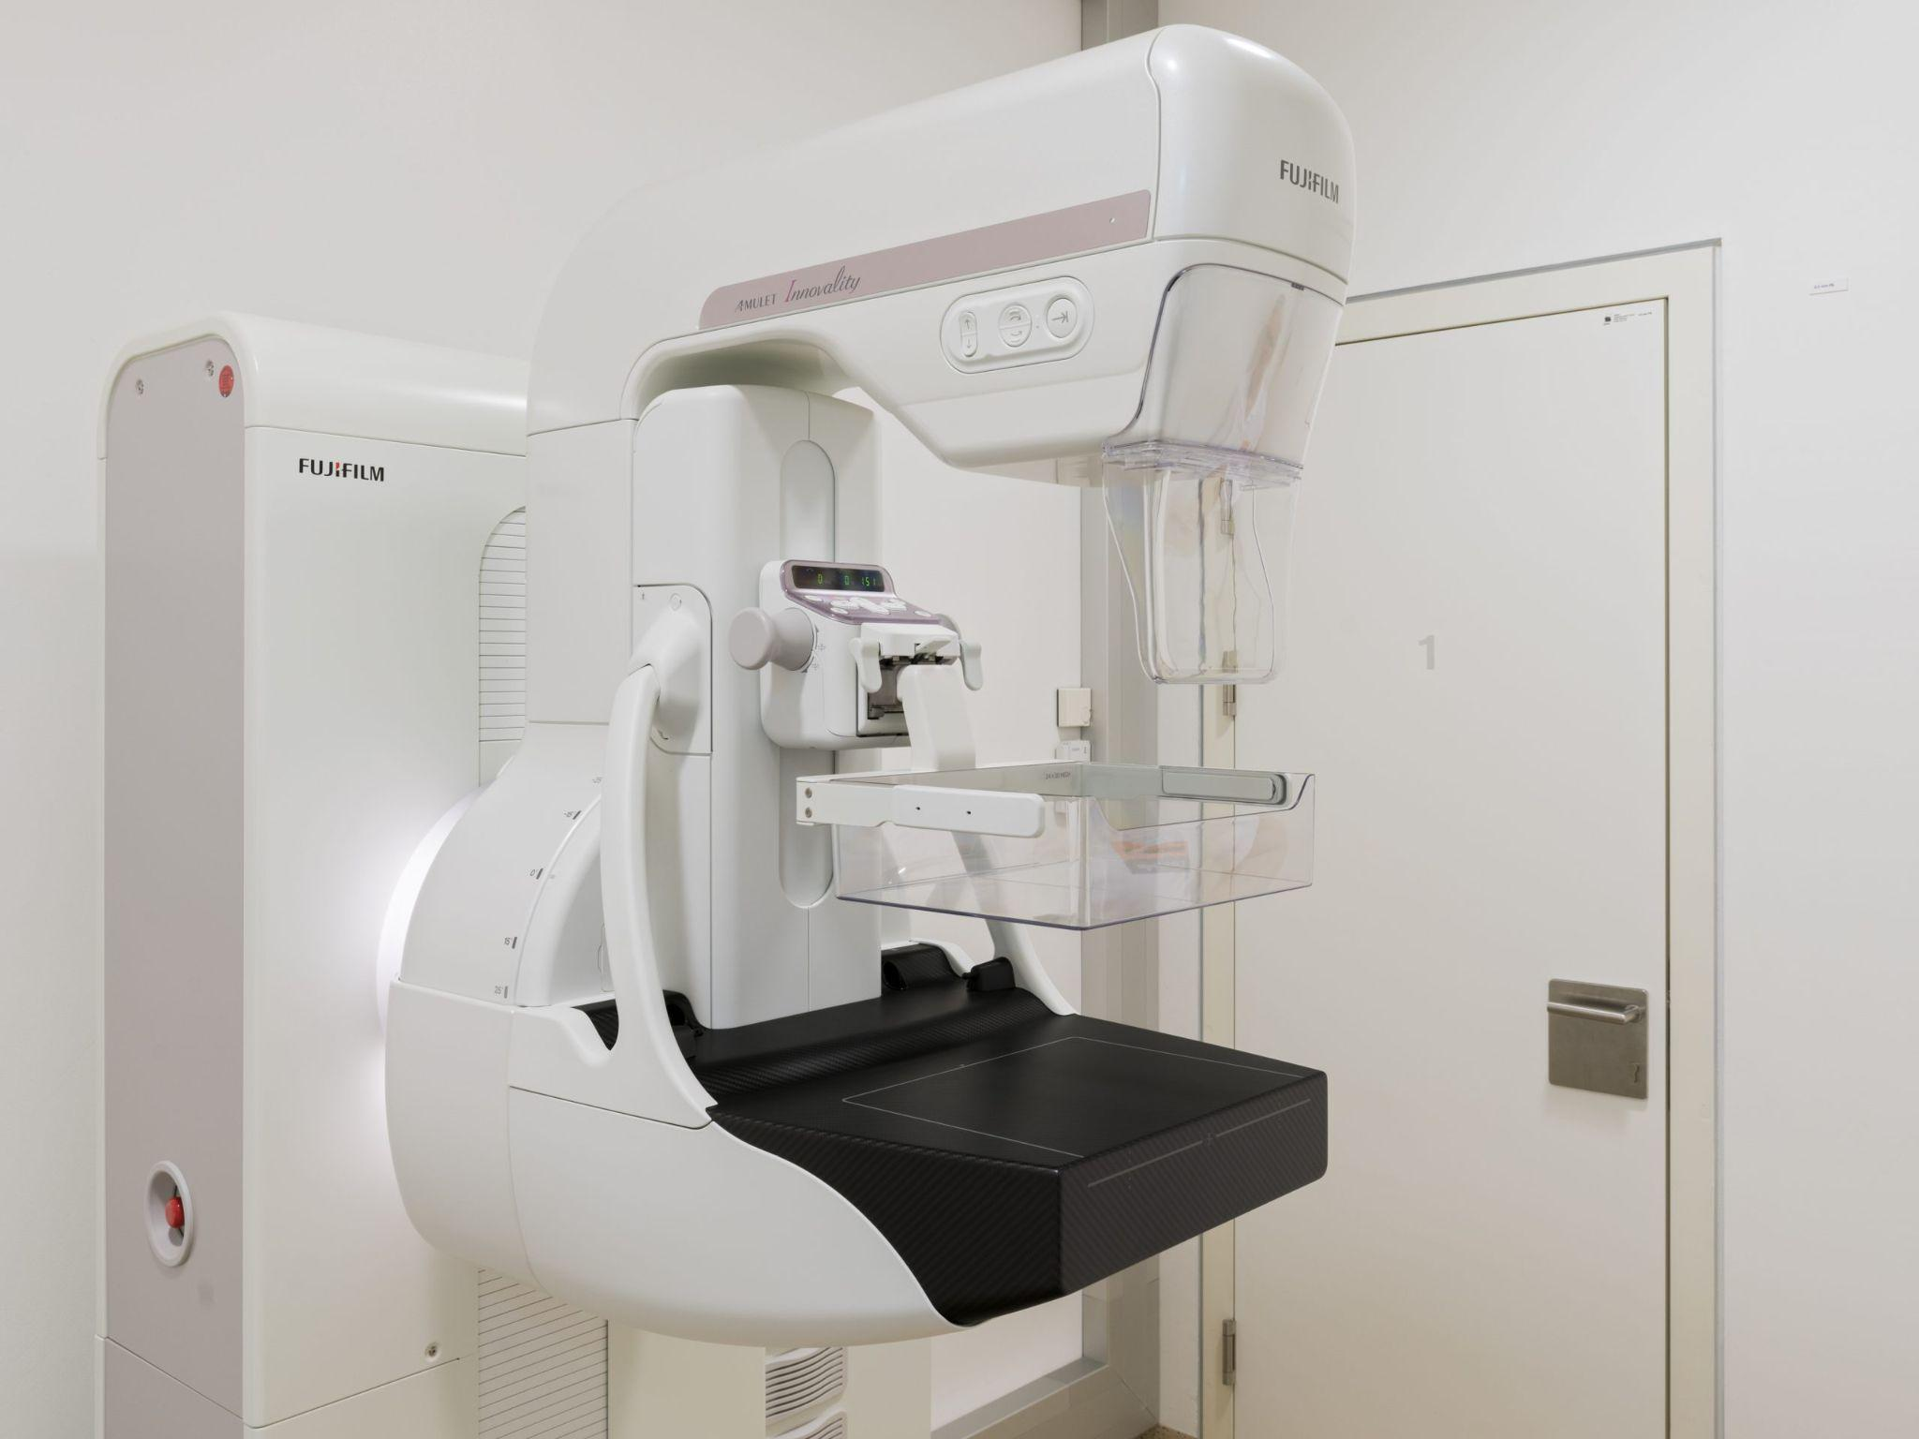
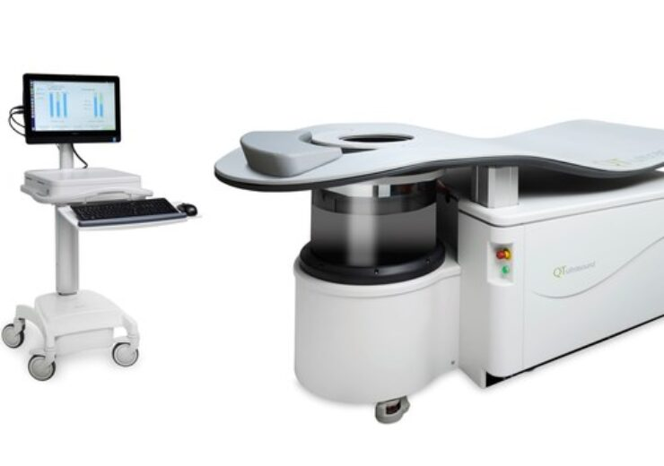
Introduction
Subject of importance due to many reasons : in 2021
281,550 new cases (U.S.)
~43,600 deaths (U.S.)
Early detection is of utmost importance.
Two ways of detection : UltraSound and Mammography.
Issues : dense tissue drops sensitivity of mammograph from 85% to 48–64%. (group most vulnerable)
Notes:
Identifying breast cancer at an early stage before metastasis enables more effective treatments and therefore significantly improves survival rates.
women with extremely dense breasts have a 4-fold increased risk of developing breast cancer.

Slide 5
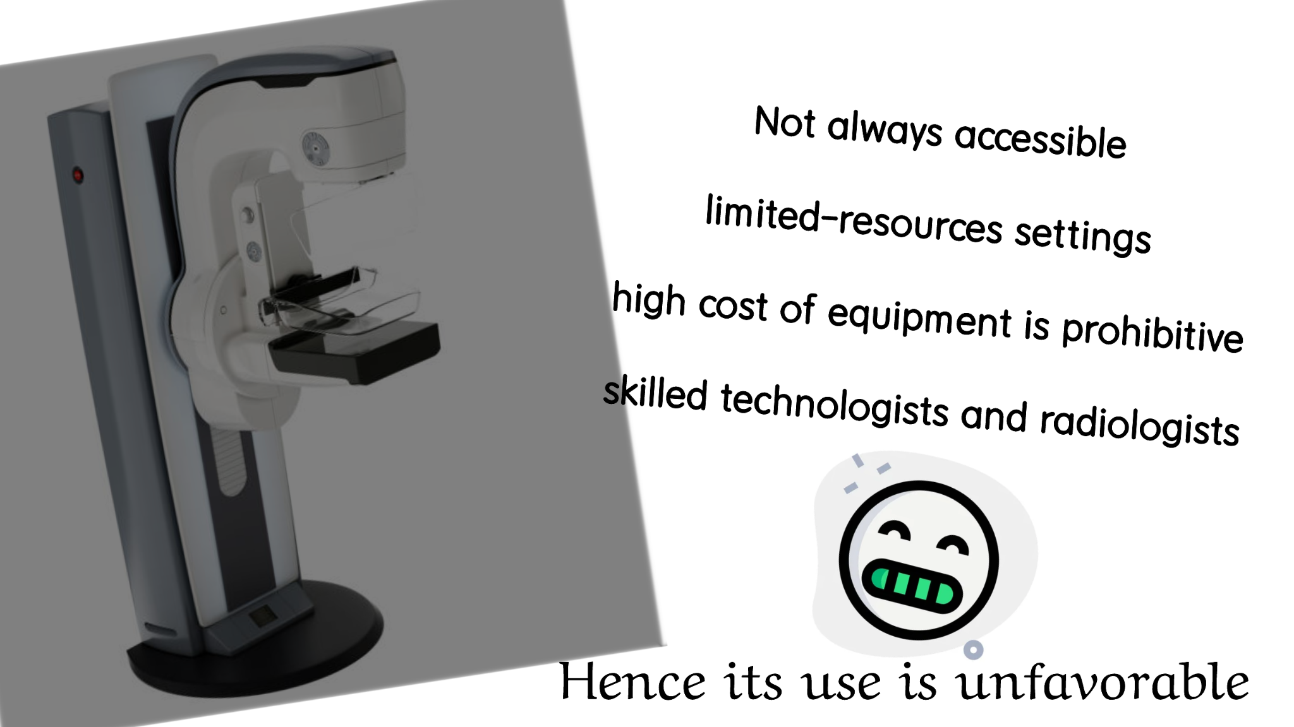
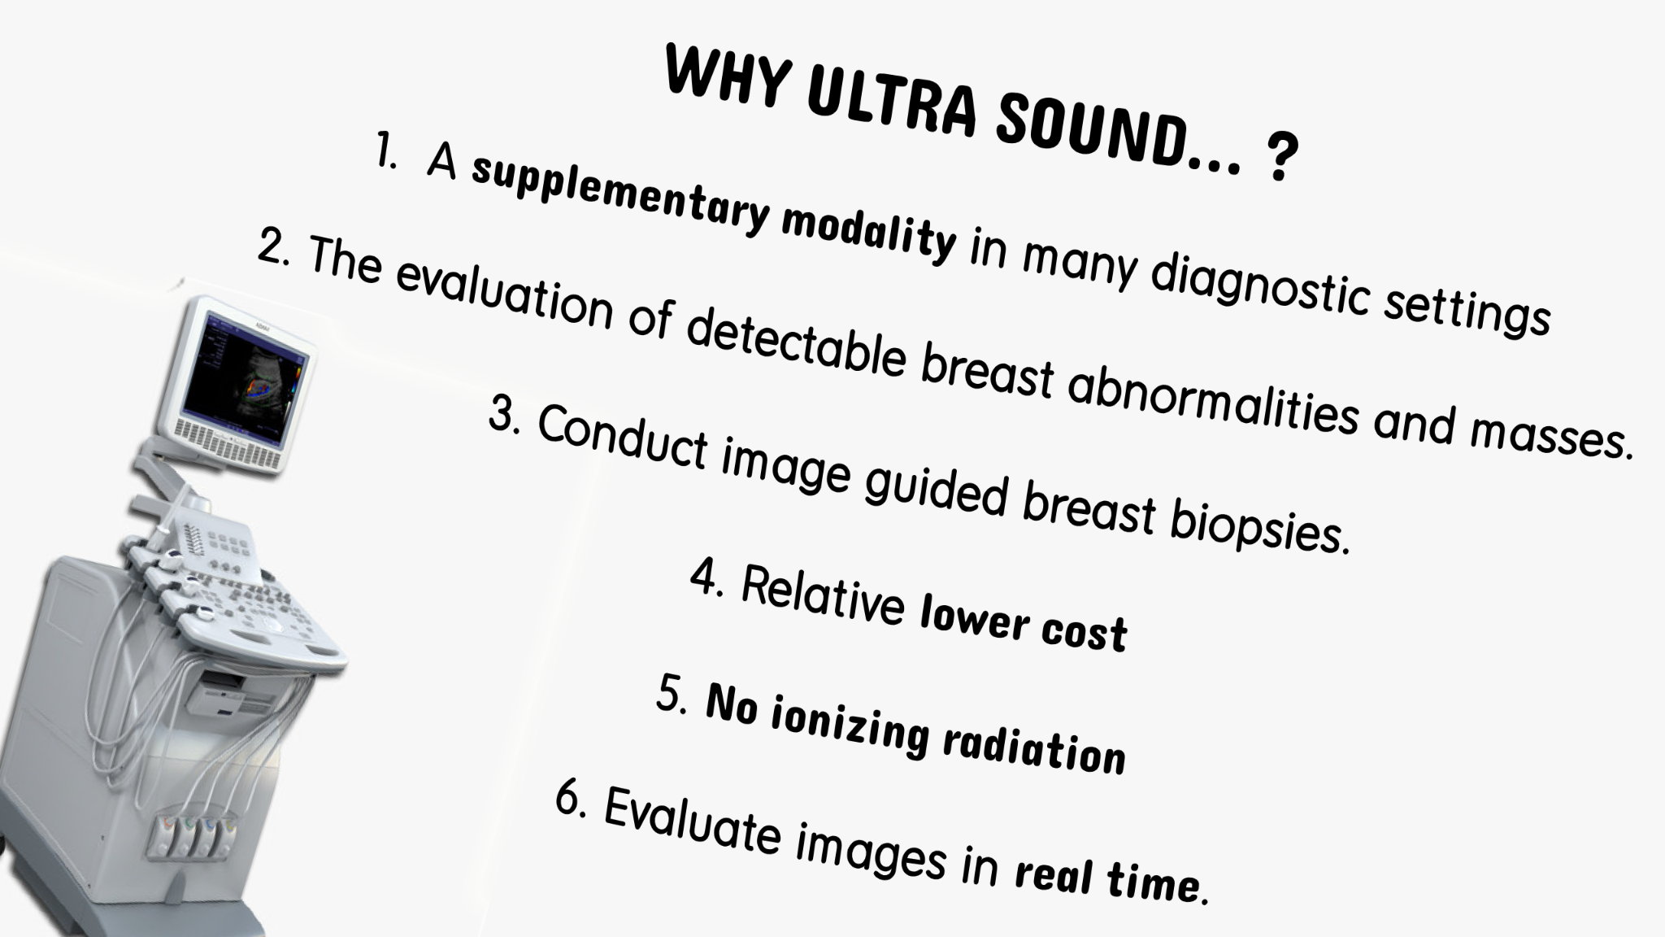
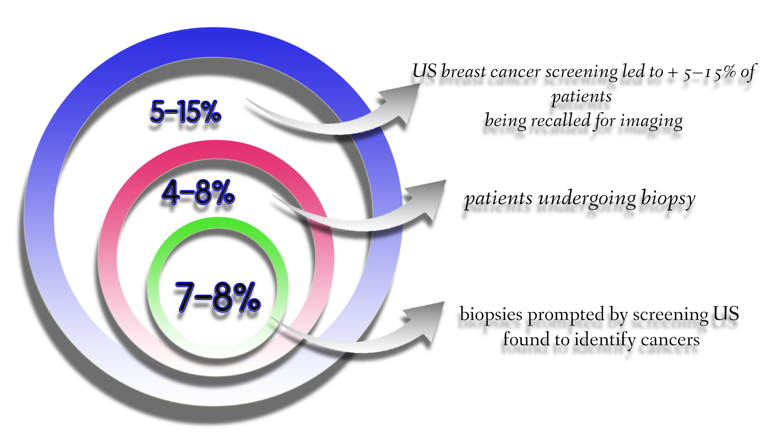
Introduction
Factors influencing follow-up imaging, test biopsy or suspicion of malignancy are features as :
Lesion size.
Shape.
Margin.
Echogenicity.
Posterior acoustic features.
Orientation.
However due to intra-reader variability in these recommendations, and breast US interpretation has led to increasing the number of false-positive findings.
Notes:
US prompts 5-15% more patients sent to imaging, out of which 4-8% go biopsy & of which 7-8% find cancers.
ability to bounce an echo, e.g. return the signal in ultrasound examinations. In other words, echogenicity is higher when the surface bouncing the sound echo reflects increased sound waves.
Posterior acoustic features may or may not be seen when imaging solid masses. Posterior acoustic shadowing is a suspicious finding and may be seen in cases of invasive carcinoma, postoperative scar, complex sclerosing lesion, or macrocalcifications and may even be seen in patients with dense breast tissue.

Slide 6


Introduction
Old V.S New
Old : Relied on handcrafted visual features that are difficult to generalize.
New : Deep learning, AI systems, automated diagnosis of breast cancer from US images .
Issue 1 : Pixel-level labels need manually mark images by expert.
Issue 2 : Existing studies done on small datasets which might not sufficient for clinical deployment.
Issue 3 : Proprietary technique is by manufacturer.
Issue 4 : Biased towards only two labels ‘benign’ & ‘malignant’.
Other Issues :
the majority of breast cancer screening exams are negative (no lesions are present).
Old systems were black box models.
Only recent study focused on explainable AI.
Notes:
Computer-aided diagnosis (CAD) systems have been proposed to assist radiologists in the interpretation of breast US exams over a decade ago.
Early CAD systems often relied on handcrafted visual features that are difficult to generalize across US images that were acquired using different protocols and US units.
Deep learning have facilitated the development of AI systems for the automated diagnosis of breast cancer from US images. However, the majority of these efforts rely on image-level or pixel-level labels, which require experts to manually mark images containing visible lesions within each exam or annotate lesions.
existing studies have been based on small datasets consisting of several hundreds or thousands of US images. Deep learning models trained on those datasets might not sufficiently learn the diverse characteristics of US images observed in clinical practice.
the imaging technique and the manufacturer of the US unit system. Moreover, prior research has primarily focused on differentiating between benign and malignant breast lesions, hence evaluating AI systems only on the images which contain either benign or malignant lesions.
In addition, most AI systems in previous studies do not interpret the model’s predictions, resulting with "black-box” models. So far, there has been little work on interpretable AI systems for breast US. In this work, we present an AI system to identify malignant lesions in breast US images with the primary goal of reducing the frequency of false positive findings. In addition to classifying the images, the AI system also localizes the lesions in a weakly supervised manner.

Slide 7

Introduction
What can their System do ?
Explain its predictions by indicating locations of malignant lesions.
Trained with binary breast-level cancer labels, extracted from pathology.
Explainability enables clinicians to develop trust and better understand its strengths and limitations.
A large dataset was used.
Compared diagnostic accuracy with ten board-certified breast radiologists.
Higher ‘AUROC’ and ‘AUPRC’ than the ten radiologists on average.
Notes:
our AI system is able to explain its predictions by indicating locations of malignant lesions
even though it is trained with binary breast-level cancer labels only (see Methods section ‘Breast-level cancer labels’), which were automatically extracted from pathology reports. The explainability of our system enables clinicians to develop trust and better understand its strengths and limitations.
the dataset used to train and evaluate this AI system is larger than any prior dataset used for this application.
higher area under the receiver operating characteristic curve (AUROC) and area under the precision-recall curve (AUPRC) than the ten radiologists on average.

Slide 8
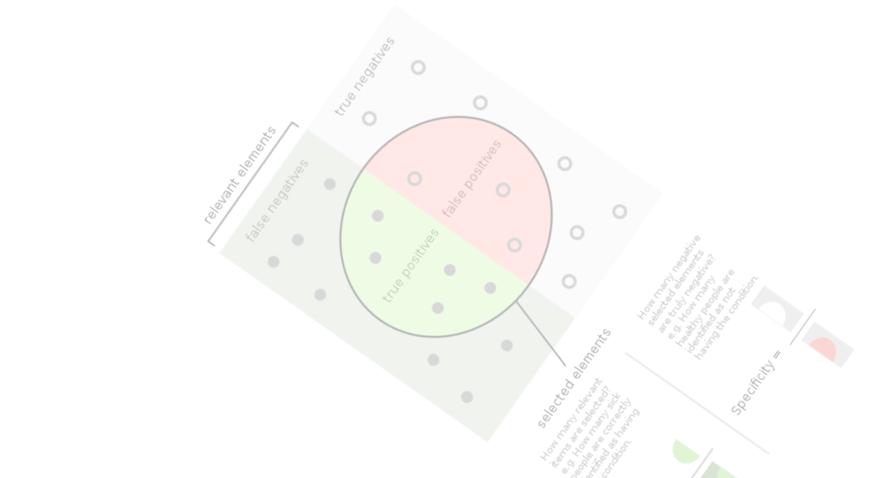
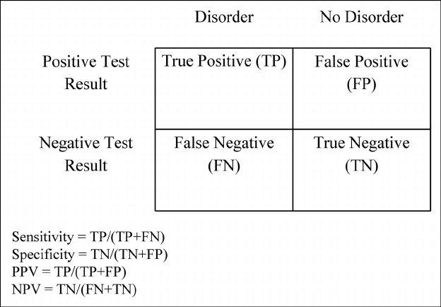
Introduction.
What can their System do ?
We also have hybrid models which have improved specificity maintaining sensitivity.
Performance of the AI system remained robust across age groups and mammographic breast densities.
Accuracy of our system also remained high when tested on an external data set.
Notes:
Moreover, we showed that the hybrid model, which aggregates the predictions of the AI system and radiologists, improved radiologists’ specificity and decreased biopsy rate while maintaining the same level of sensitivity.
performance of the AI system remained robust across patients from different age groups and mammographic breast densities. Accuracy of our system also remained high when tested on an external data set.
Positive predictive values (PPV)
Negative predictive values (NPV)

Slide 9
Content
Introduction. S.no 3
Methods. S.no 10
Results. S.no 12
Performance. S.no 17
Use cases S.no 25
Discussion S.no 28
Conclusion S.no 32
References. S.no 34

Slide 10

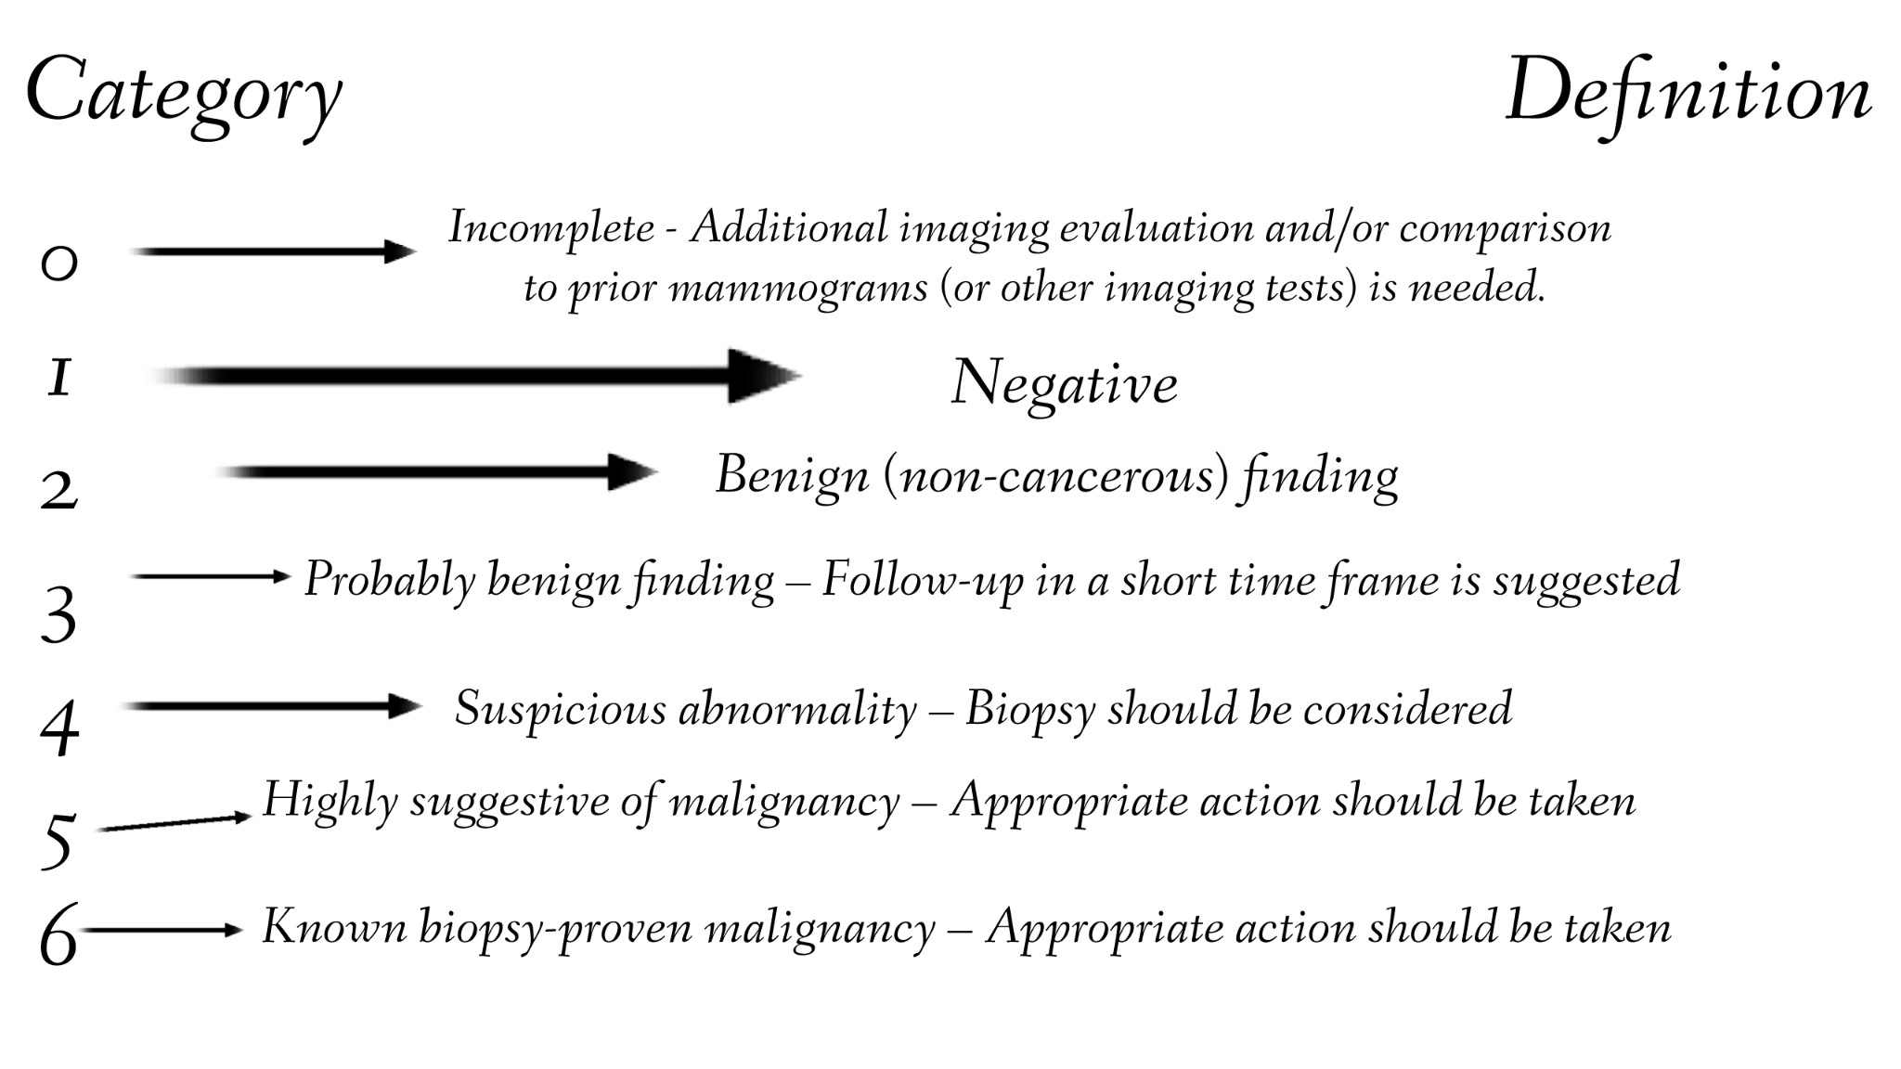
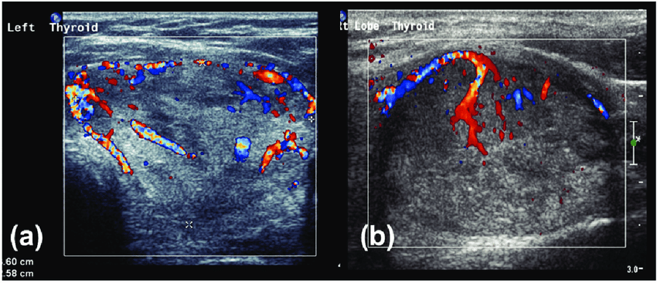
Methods
Approval : The NYU Langone Health Institutional Review Board.
US Dataset dataset contained 288,767 exams (5,442,907 images) acquired from 143,203 patients imaged between January 2012 and September 2019 (665 × 603 pixels Doppler on B-mode)
Cancer labels (approximately 10%) were associated with at least one pathology report dated Pathology reports were used to automatically detect cancer labels.
Breast ultrasound images dataset. from Baheya Hospital for Early Detection and Treatment of Women's Cancer images, with an average resolution of 500 × 500 pixels.
data reproducibility : https://cs.nyu.edu/~kgeras/reports/ultrasound_datav1.0.pdf
Data link : https://scholar.cu.edu.eg/Dataset_BUSI.zip
Notes:
US Dataset We extracted breast tissue density from the patient's past mammography reports and assigned "unknown” to patients who did not have any mammography exams. Both screening and diagnostic US exams were included. diagnostic US exams can be used to evaluate women who present with symptoms While screening exams are typically comprehensive and image both breasts, diagnostic US exams vary in.
Filter dataset exams consisting of 8,448,978 images collected from 212,716 unique patients. younger than 16 years of age, duplicate images, exams from non-female patients, and invalid images based on the ImageType attribute, which consisted of non-US images with more than 80% zero pixels, exams with multiple patient identifiers or Patients were then randomly split among training (60%), validation (10%) and validation, and test sets. The training set consisted of 3,930,347 images within 209,162 exams collected from 101,493 patients. The validation set consisted of 653,924 images within 34,850 exams collected from 16,707 patients. Consisted of 858,636 images within 44,755 exams collected from 25,003 patients. test set was used to evaluate the performance of the models selected using the
cancer labels (approximately 10%) were associated with at least one pathology report dated Pathology reports were used to automatically detect cancer labels. Malignant findings included primary breast cancers: invasive ductal carcinoma, invasive lobular carcinoma, special-type invasive carcinoma (including automatically extracted from the corresponding pathology reports using a natural Of note, patients with multiple pathology reports could be assigned both malignant and benign labels if their exam
Breast ultrasound images dataset. from Baheya Hospital for Early Detection and Treatment of Women's Cancer images, with an average resolution of 500 × 500 pixels, acquired from 600 female Among these 780 images, the original paper for more information about this public dataset.
statistical analysis In this study, we evaluated the performance of the AI system, radiologists, and the hybrid models using the following evaluation metrics: area under receiver operating characteristic curves (AUROC), area under precision-recall curve (AUPRC), sensitivity, specificity, biopsy rate, negative predictive value (NPV), and AUROC and AUPRC were used to assess the diagnostic accuracy of the probabilistic predictions generated by the AI system/hybrid In addition, we also evaluated the binary predictions of the AI system, the hybrid models, and the readers using sensitivity, specificity, biopsy rate, NPV, and breast, the AI system and the hybrid models produced a probabilistic score that produce binary predictions by selecting a score threshold that separates positive specificity, biopsy rate, PPV and NPV, we dichotomized the AI system’s dichotomized the predictions of each hybrid model using the sensitivity/specificity In the reader study, we compared the AUROC, AUPRC, sensitivity, specificity, PPV, and biopsy rate of the AI system and hybrid models with those of the average hybrid model’s score with one of the comparator reader’s score for each case.
code and data availablity Data availability Data supporting the results demonstrated by this study are available within the main text For any further queries regarding data availability, please contact the networks, sufficient to evaluate our system on other datasets, are available for research Requests will be answered within one week.
Breast Imaging Reporting And Data System (BI-RADS)

Slide 11
Content
Introduction. S.no 3
Methods. S.no 10
Results. S.no 12
Performance. S.no 17
Use cases S.no 25
Discussion S.no 28
Conclusion S.no 32
References. S.no 34

Slide 12
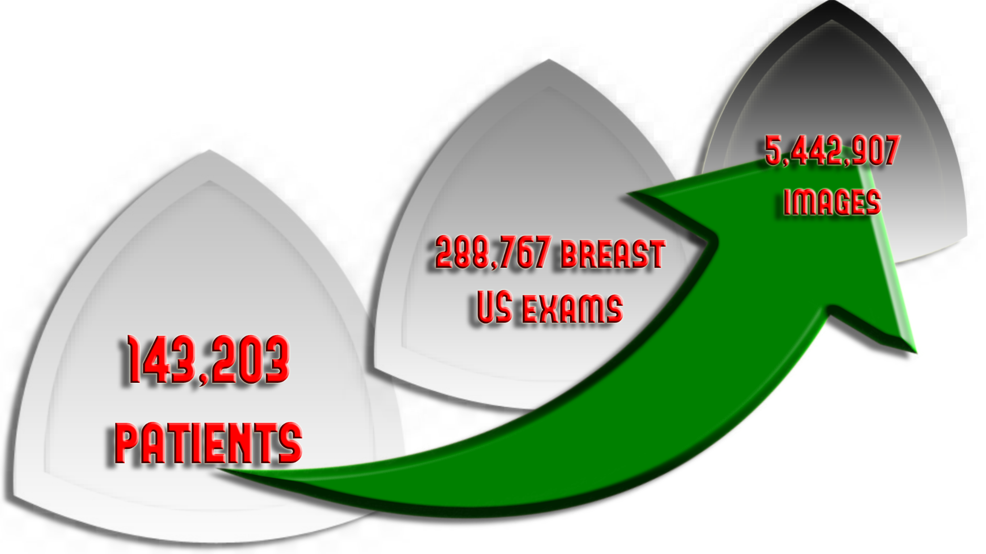
Results
NYU Breast Ultrasound Dataset collected between 2012 and 2019 at NYU Langone Health in New York from a diverse patient population.
The dataset included 28,914 exams which yielded benign and malignant results for 26,843 and 5593 samples collected.
Patient dataset - training set (60%-model training) hyperparameter tuning (10%-validation set) model evaluation(30%-internal test) (Each patient was included in only one of the three sets.)
Each sample within an exam was assigned a label.
Collected over 30 days prior or 120 days to include lesions found at primary screening and lesions found during targeted US via other modality.

Slide 13
Results
2 sets : Internal set and External set.
Cancers in positive exams are visible in the US images.
Negative exams have at least one cancer-negative follow-up.
The AI system uses probabilistic prediction to generate saliency maps.
Internal test set (AUROC: 0.976, 95% CI: 0.972, 0.980, n = 79,156 breasts)
External test set (AUROC: 0.927, 95% CI: 0.907, 0.959, n = 780 images)
Important :
In a reader study consisting of 663 exams (n = 1024 breasts) the AI system improved the specificity and positive predictive value (PPV) for 10 attending radiologists, maintaining the same level of sensitivity and negative predictive value (NPV).
Notes:
Test set (external validation): these sets/trials are not used in any way during training and validation (ie. parameter tuning, model selection).
Validation set (internal validation): these sets/trials are not used during training of models, but are used for comparing different models to select one or tune parameters, etc. Read about nested cross-validation.
Training set: these are the sets/trials whose samples you use to fit/train your model.

Slide 14
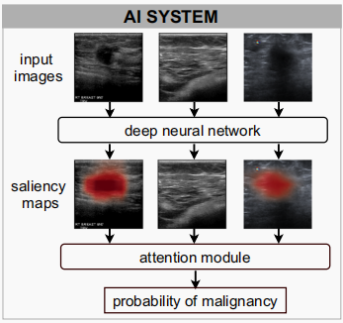
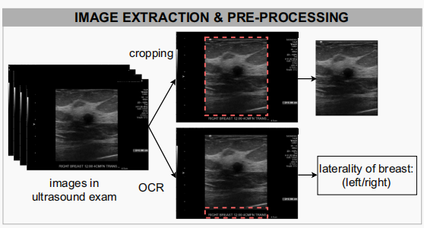
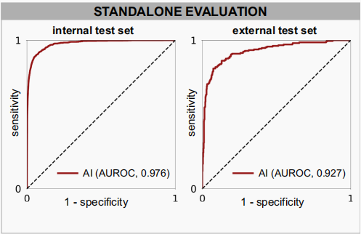
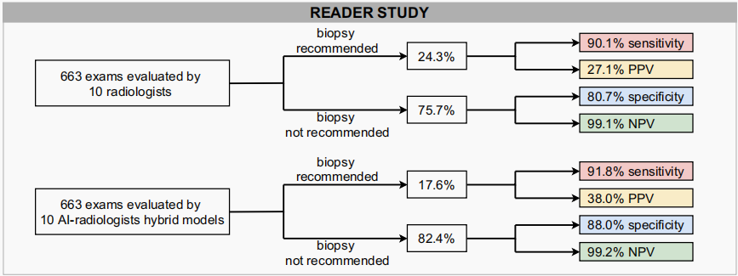
Overview
Notes:
Test set (external validation): these sets/trials are not used in any way during training and validation (ie. parameter tuning, model selection).
Validation set (internal validation): these sets/trials are not used during training of models, but are used for comparing different models to select one or tune parameters, etc. Read about nested cross-validation.
Training set: these are the sets/trials whose samples you use to fit/train your model.

Slide 15
Results
This external test set consisted of 780 images (437-benign, 210-malignant,133-negative lesions).
These images were collected from 600 patients, which were from a diverse population with labels indicative of malignancy.
Notes:
Test set (external validation): these sets/trials are not used in any way during training and validation (ie. parameter tuning, model selection).
Validation set (internal validation): these sets/trials are not used during training of models, but are used for comparing different models to select one or tune parameters, etc. Read about nested cross-validation.
Training set: these are the sets/trials whose samples you use to fit/train your model.

Slide 16
Content
Introduction. S.no 3
Methods. S.no 10
Results. S.no 12
Performance. S.no 17
Use cases S.no 25
Discussion S.no 28
Conclusion S.no 32
References. S.no 34

Slide 17
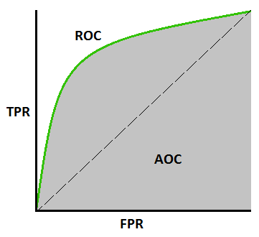
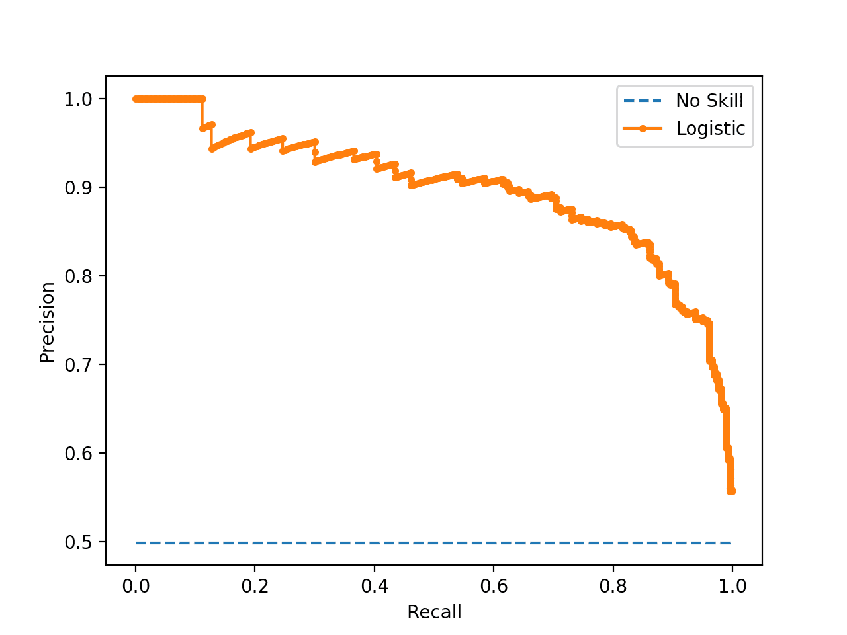
Prerequisite Knowledge
ROC AUC :
The Area Under an ROC(Receiver operating characteristic) Curve ( The diagnostic ability of a binary classifier system)
AUPRC :
The Area Under Precision-Recall Curve (Useful performance metric for imbalanced data in a problem setting where you care a lot about finding the positive examples)
Notes:
AUROC : The method was originally developed for operators of military radar receivers starting in 1941, which led to its name.
95% confidence interval means that if we were to take 100 different samples and compute a 95% confidence interval for each sample, then approximately 95 of the 100 confidence intervals will contain the true mean value (μ).
how stable the estimate is.

Slide 18
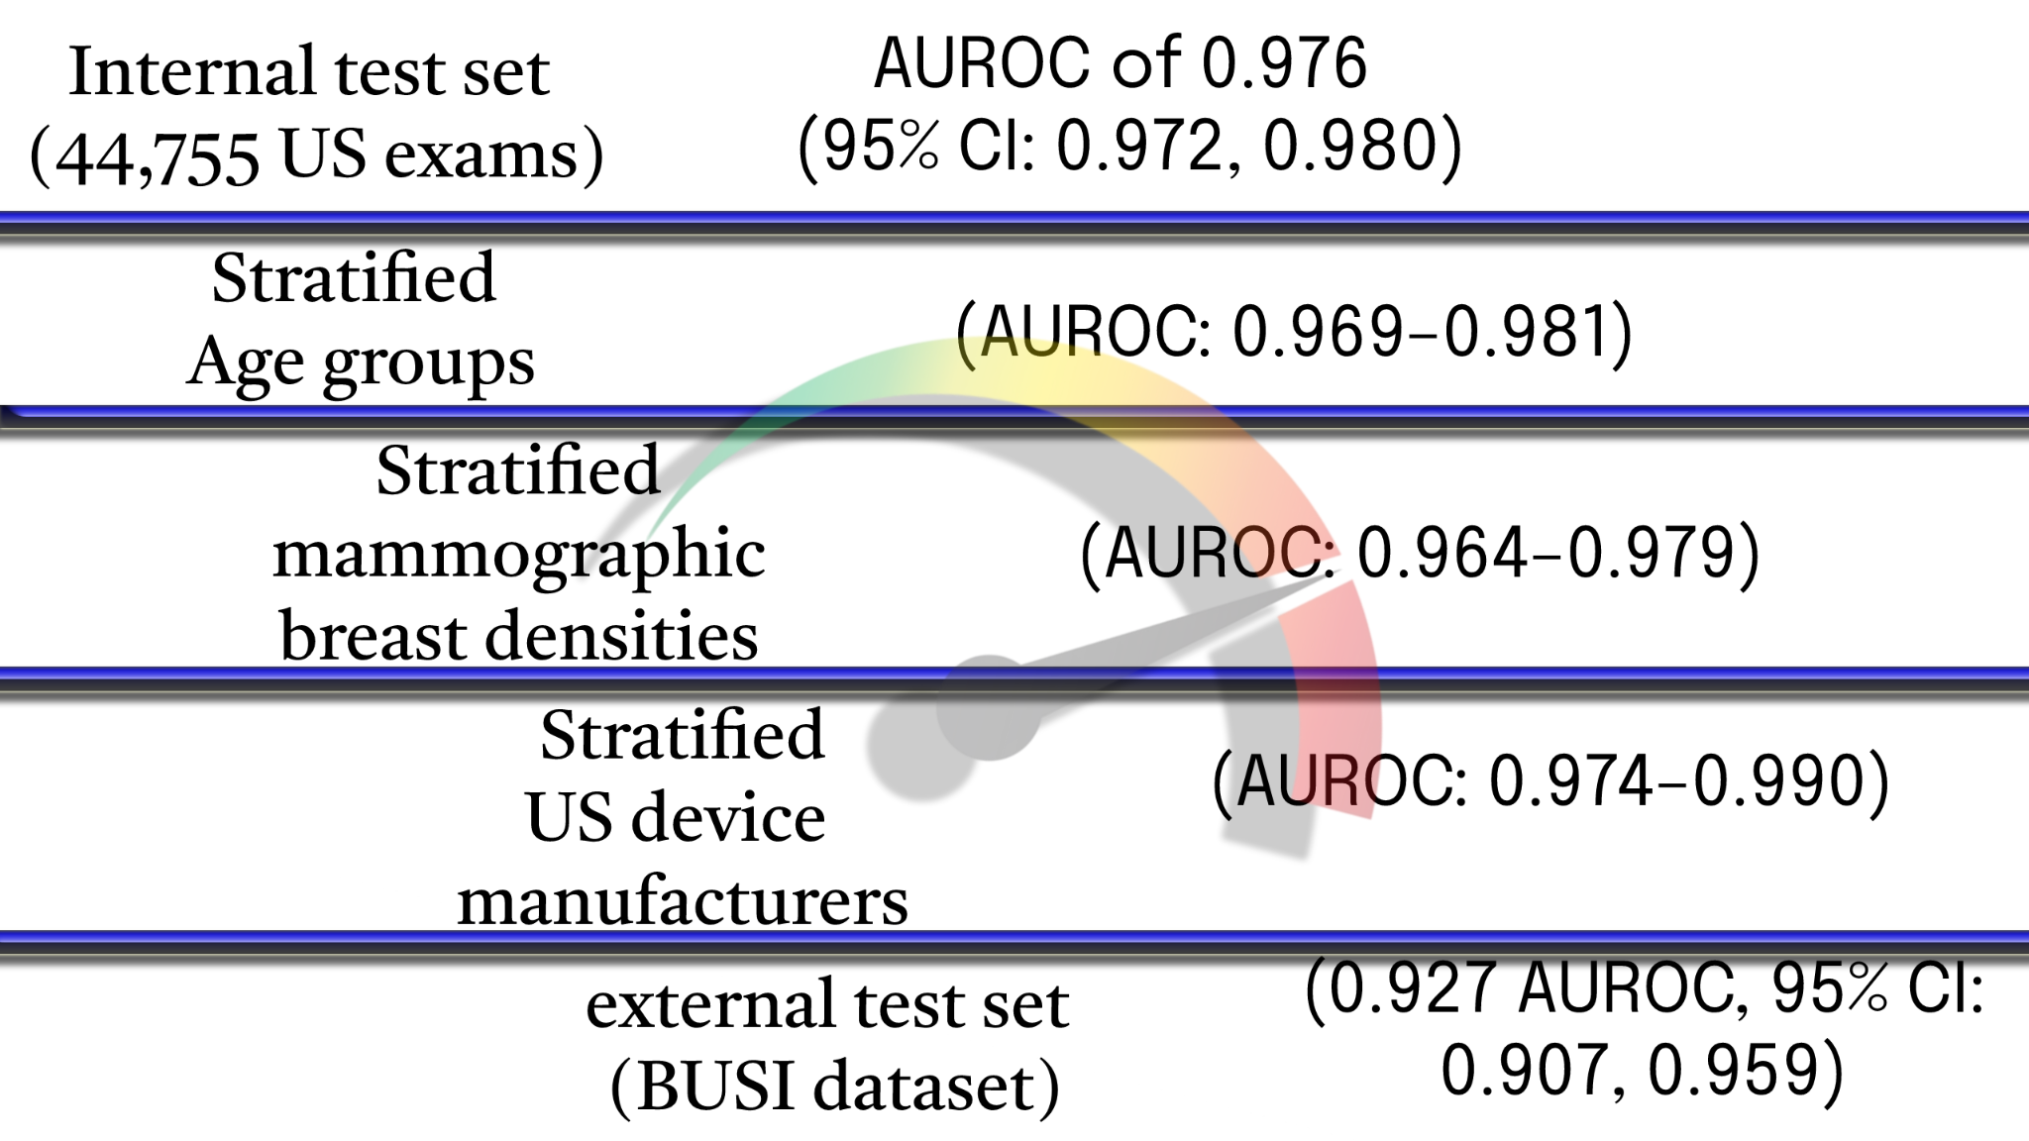
Performance
They found the impact of training dataset size on the performance of AI system :
“ We observed that more training data led to a better AUROC “
Notes:
In a stratified sample, researchers divide a population into homogeneous subpopulations called strata (the plural of stratum) based on specific characteristics.

Slide 19
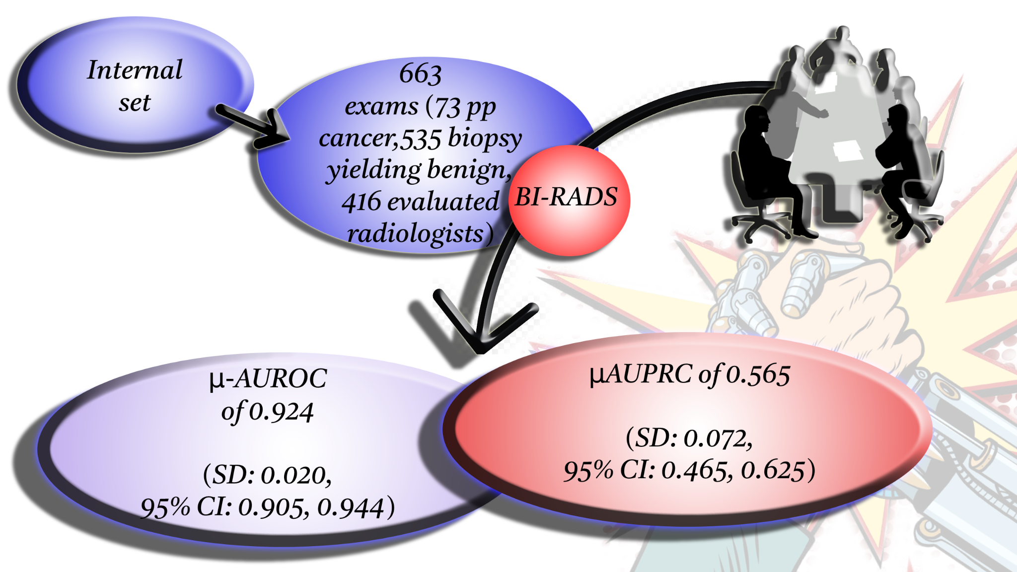
Performance
Man V Machine
Any bets .. ?
An average specificity of
80.7%
(SD: 4.7%, 95% CI: 78.9%, 82.6%)
An average sensitivity of
90.1%
(SD: 4.3%, 95% CI: 86.4%, 93.8%).
Notes:
From the internal test set, we constructed a reader study subset by selecting 663 exams (644 patients, 1024 breasts).
Among the exams selected for this study, 73 breasts had pathology-proven cancer, 535 breasts had a biopsy yielding exclusively benign findings, and 416 breasts were not biopsied but were evaluated by radiologists as likely benign and had a follow-up benign evaluation at 1–2 years.
Readers were informed that the study dataset was enriched with cancers but were not informed of the enrichment level.
Ten board-certified breast radiologists rated each breast according to the Breast Imaging Reporting and Data System (BI-RADS).
Readers were provided with contextual information typically available in the clinical setting, including the patient’s age, burnt-in annotations showing measurements of suspicious findings, and notes from the technologist, such as specifying any region of palpable concern or pain. In contrast, the AI system was not provided any contextual information.
The ten radiologists achieved an average AUROC of 0.924 (SD: 0.020, 95% CI: 0.905, 0.944) and
an average AUPRC of 0.565 (SD: 0.072, 95% CI: 0.465, 0.625).

Slide 20
Performance
How did AI do …!!
AUROC improvement of
0.038
(95% CI: 0.028, 0.052, P < 0.001)
AUPRC of 0.752
(95% CI: 0.675, 0.849)
AUPRC improvement of
0.187
(95% CI: 0.140, 0.256, P < 0.001)
AUROC of 0.962
(95% CI: 0.943, 0.979)
Notes:
For each reader, we computed a receiver operating characteristic (ROC) curve and a precision-recall curve by comparing their BI-RADS scores to the ground-truth outcomes.
Compared to the average radiologist in this study, the AI system achieved a higher

Slide 21
Performance
How did AI do …!!
Increased
specificity
of
4.9%
(95% CI: 3.0%, 7.1%; P < 0.001)
Improved sensitivity
of
4.4%
(95% CI: −0.3%, 7.5%,
P = 0.0278)
specificity of 85.6%
(95% CI: 83.9%, 88.0%)
sensitivity of 94.5%
(95% CI: 89.4%, 100.0%)
Notes:
In addition, we also compared the specificity and sensitivity achieved by the AI system and radiologists.
We assigned a positive prediction to any breast a radiologist gave a BI-RADS score of ≥4, and a negative prediction to any breast that was given a BI-RADS score of 1–3. A BI-RADS score of ≥4 is an assessment that indicates a radiologist thinks an exam is suspicious for malignancy.
This was selected as the threshold for positive predictions since this is the score above which a patient will typically undergo an invasive procedure (biopsy or surgical excision) to definitively determine whether they have cancer.

Slide 22
Performance
AI system
recommended
tissue biopsies on 19.8%
(95% CI: 17.9%,22.1%)
of
samples
Overall..
32.5%
(95% CI: 26.9%, 39.2%)
of these biopsies
had
cancer
This matches :
18.6% of all biopsies recommended by the average radiologist
Improved
PPV of 5.4%
(95% CI: 2.4%, 8.9%, P < 0.001).
Absolute reduction biopsy rate
of
4.5%
(95% CI: 2.9%, 6.5%,
P < 0.001)

Slide 23
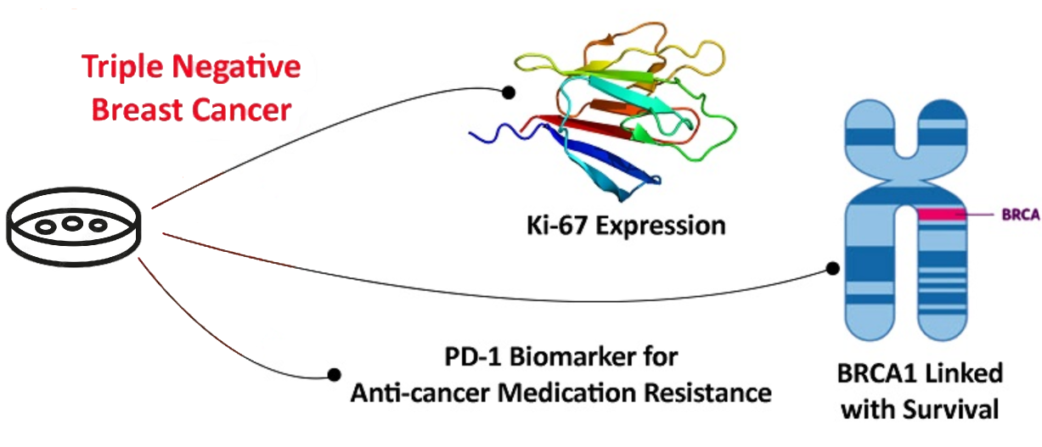
Performance
Subgroup analysis on the biopsied population
Two clinically subgroups study for AI system and radiologists :
Radiologists : AUROC (mean: 0.896), specificity (mean: 69.8%) and Increased average biopsy rate to 37.4%.
AI system achieved an AUROC (0.941), specificity (8.5%) and reduced biopsy rate 7.5% and PPV of 6.7%.
AI can’t characterize breast cancer (triple biomarker-negative cancers) which are benign tumors and oval shaped.
This analysis demonstrated that the sensitivity of the AI system was similar to that of the readers across all stratification categories.
Ki-67 expression is closely related to the TNBC phenotype.
BRCA1 promoter methylation has been linked to low overall survival in TNBC patients.
PD-1 is a biomarker for anti-cancer medication resistance.

Slide 24
Content
Introduction. S.no 3
Methods. S.no 10
Results. S.no 12
Performance. S.no 17
Use cases S.no 25
Discussion S.no 28
Conclusion S.no 32
References. S.no 34

Slide 25
Use Cases
Saliency maps and AI systems utility can be used as decision support tool.(interpretable data for radiologists)
Case where AI and Study group(7/10) agreed : irregularly hypoechoic masses & indistinct margins was found to be invasive ductal carcinoma was identified as suspicious for malignancy.
Case where AI and Study group(7/10) doubted : cystic/solid nodule,microlobulated contour feature was identified as benign but was invasive ductal carcinoma.
Case where AI and Study group(9/10) failed : superficial hypoechoic mass was benign fat necrosis was identified as suspicious for malignancy.
Case where AI and Study group(10/10) disagreed : 2 of heterogeneous lobulated solid nodule was seen as suspicious by study group. But AI system classified it as benign. (was actually fatty tissue)

Slide 26
Use Cases
‘Hybrid model’ has equally weighted average between the AI system and each reader with improved predictions, some metrics are below :
Improved AUROC by 0.037 and AUPRC by 0.219.
Specificity improved from 80.7% to 88.0%.
Increased their PPV from 27.1% to 38.0%.
Decreased average biopsy rate from 24.3% to 17.6%..
Overall reduction in biopsies by 27.8% by radiologists.
Allows to dismiss 77.7% of normal/benign cases and only focus on cancer cases.
Only 27.1% biopsies that radiologists recommended had cancer via clinical studies.

Slide 27
Content
Introduction. S.no 3
Methods. S.no 10
Results. S.no 12
Performance. S.no 17
Use cases S.no 25
Discussion S.no 28
Conclusion S.no 32
References. S.no 34

Slide 28
Discussion
PROs :
Maintained a high level of diagnostic accuracy, comparably to board-certified breast radiologists.
The group study, on average 19.3% of cancer-negative exams were falsely diagnosed as positive and only 27.1% had cancer.
The hybrid model reduced false positive rate by 37.3% and PPV by 38.0%.
Dismiss majority of low-risk benign exams and focus on high-risk cases.
Requires training and validation on large-scale datasets to ensure the network will function well across the broad spectrum.
Weakly supervised learning paradigm can train models at scale without image level or pixel-level labels.(automatically extract labels)
Notes:
These results indicate that our AI system has the potential to aid radiologists in their interpretation of breast US exams to reduce.
The number of false positive interpretations and benign biopsies performed.
where noisy, limited, or imprecise sources are used to provide supervision signal for labeling

Slide 29
Discussion
Generate interpretable saliency maps.
AI system achieved higher diagnostic accuracy with AUROC: 0.976 more than prior AI systems for breast US lesion classification (AUROC: 0.82-0.96).
They achieved a higher diagnostic accuracy (AUROC: 0.976) on a larger diverse patient population, could enable radiologists to achieve even greater levels of performance.

Slide 30
Discussion
CONs :
Uses US imaging is a complementary modality.
No account of risk factors as family history of breast cancer or BRCA gene test results.
Breast radiologists have access to other information as patient breast imaging,screen settings, multi modalities.
Images in external test set were acquired by single US system, the technicians acquire multiple images from different views which are suspicious of malignancy.
Studies used small datasets and did not evaluate the AI’s performance on sub-populations stratified by age and breast density, system wouldn’t maintain performance across the broad range.
Notes:
breast radiologists often refer to patients’ prior imaging to evaluate the morphological changes of suspicious findings over time.
complementary modality to mammography, cancer study is led multimodally.

Slide 31
Content
Introduction. S.no 3
Methods. S.no 10
Results. S.no 12
Performance. S.no 17
Use cases S.no 25
Discussion S.no 28
Conclusion S.no 32
References. S.no 34

Slide 32
Conclusion
Deep learning models trained on large amount of data are able to produce diagnosis accurate as experienced radiologists.
Hybrid models made enhanced specificity and obviate 27.8% of requested biopsies.
Weakly supervised classification and localization, may enable utilization of deep learning.
Unable to determine patterns where the AI system correctly contradicted the majority of readers.
With appropriate localization information, the AI system might help human readers with more accurate diagnoses.

Slide 33
Content
Introduction. S.no 3
Methods. S.no 10
Results. S.no 12
Performance. S.no 17
Use cases S.no 25
Discussion S.no 28
Conclusion S.no 32
References. S.no 34

Slide 34
References
Shen, Y., Shamout, F. E., Oliver, J. R., Witowski, J., Kannan, K., Park, J., Wu, N., Huddleston, C., Wolfson, S., Millet, A., Ehrenpreis, R., Awal, D., Tyma, C., Samreen, N., Gao, Y., Chhor, C., Gandhi, S., Lee, C., Kumari-Subaiya, S., … Geras, K. J. (2021). Artificial intelligence system reduces false-positive findings in the interpretation of breast ultrasound exams. Nature Communications 2021 12:1, 12(1), 1–13. https://doi.org/10.1038/s41467-021-26023-2

Slide 35


